Slide 1
1、Bluetooth Driver
rfkill
driver
kernel/drivers/bluetooth
kernel/net/rfkill/rfkill-bt.c
hci_uart.o rtk_btusb.o
hci_h4.o hci_ldisc.o
hci_ll.o
rfkill.o
rfkill-bt.o

Slide 2
2、 Bluetooth Hareware
broadcom
hardware/broadcom/libbt
libbt-vendor.so
libbt-vendor_uart.so
libbt-vendor_usb.so
bluetooth_rtk.default.so
bluetooth-cli-rtk
bluetoothtbd-rtk
bt-example-hr-server-rtk
realtek
hardware/realtek/rtkbt

Slide 3
3、 Bluetooth JNI
packages/apps/Bluetooth/jni
out/target/product/rk322x_box/system/app/Bluetooth/lib/arm/ libbluetooth_jni.so

Slide 4
4、 Bluetooth APP
packages/apps/Bluetooth/src/com/android/bluetooth
out/target/product/rk322x_box/system/app/Bluetooth/ Bluetooth.apk
packages/apps/Settings/src/com/android/settings/bluetooth
out/target/product/rk322x_box/system/priv-app/Settings/ Settings.apk

Slide 5
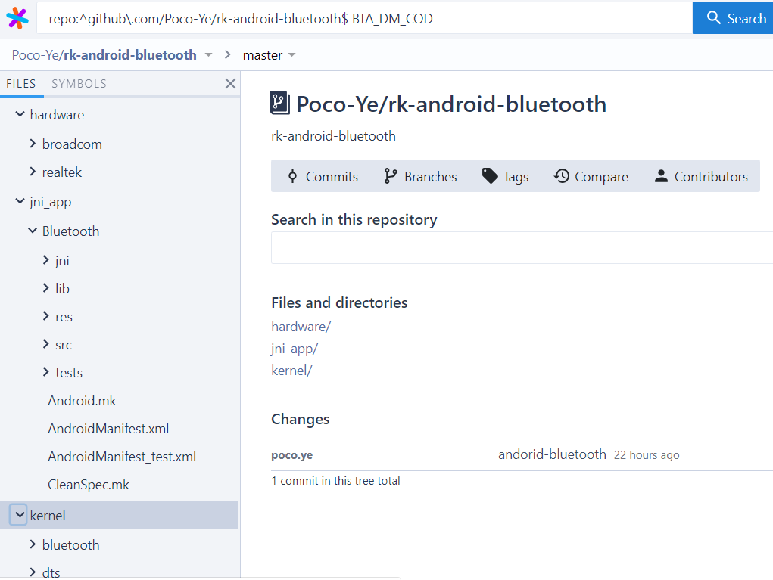
5、 andorid bluetooth sourcegraph
2019/4/12
poco

